Slide 1

Protecting Data in Higher Education:
Benchmarking, Classification, and the Role of Secured Clouds
Brendan Walker-Munro – Senior Lecturer (Law), Southern Cross University
Nikki Peever – Director, Cybersecurity CAUDIT

Slide 2
Scope for Today
Universities and higher education research institutions are having to confront a wide variety of cybersecurity threats, from motivated lone actors through to State-sponsored hacking groups.
This in turn has led to universities having a greater role to play in the securing of their research data, which could contain intellectual property or sensitive information with a significant economic value.
This webinar will show the increased priority being given by universities to protect these types of data, and the emergence of secured cloud environments as a mechanisms for ensuring appropriate and authorised access to research information.

Slide 3
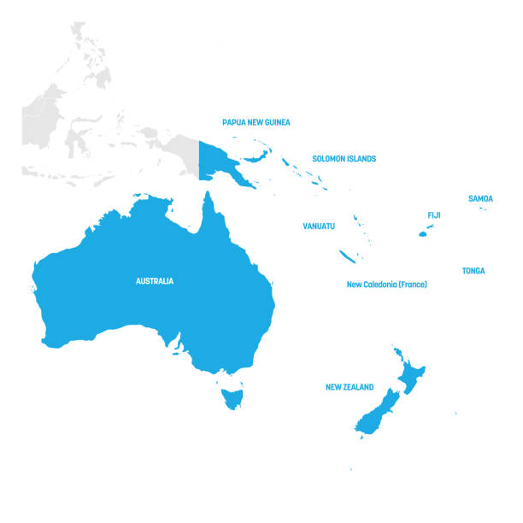

Peak member Association supporting the use of
information technology in higher education and research in Australasia
Our 69 members include:
All public universities in Australia and New Zealand along with those of Papua New Guinea and Fiji
Private higher education institutions
Key national research institutions in Australia (i.e., CSIRO, Defence Learning)
Some Australian TAFEs.
CAUDIT’s 49 ANZ university representatives lead over 9,700 staff and invest over $3.87B in IT.
Notes:
For anyone who does not know – the Council of Australasian University Directors of Information Technology (CAUDIT) is a not-for-profit member association with 69 members in Australia, New Zealand, Fiji and PNG.
CAUDIT formally began in 1976, and informally 10 years prior to that and is funded and directed by its Member Representatives. These are the most senior person leading IT in their institution - the CIO, CDOs and IT Directors.
CAUDIT’s purpose is to support each other in leading the application of digital capabilities to transform education and research. Three key strategies provide the focus for CAUDIT’s activities: connecting, enabling and challenging our members.
In response to cybersecurity being voted as their number one priority for collective action by the CAUDIT Member Representatives in October 2018, a working group was formed and in March 2019 was expanded to include AusCERT, AARNet, REANNZ and AAF. The Australasian Higher Education Cybersecurity Service (AHECS) was formed as a result.

Slide 4
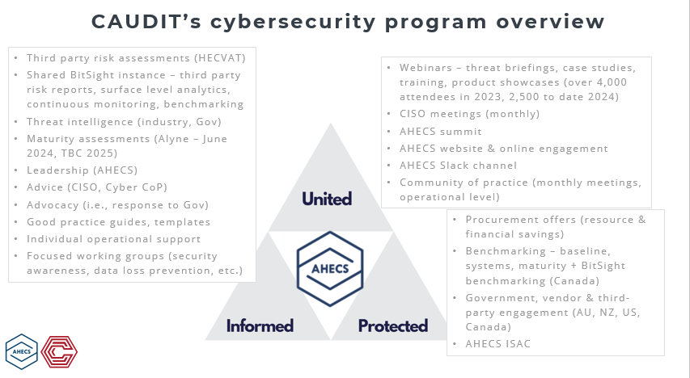
Notes:
AHECS’ goals cover a range of collaborative activities, in a trusted environment, aligned with the principles of being stronger together and ‘all boats lift on a rising tide’.
Naturally, this includes helping members address the UFIT cybersecurity guidelines – and these are incorporated into the various AHECS workstreams.
These partners form a natural fit in this endeavor. I won’t go into the detail for each partner at this point however feel free to ask if you have any questions re this aspect of the activity.
There are a range of elements, deliverables, and value of the cybersecurity program.
I’ve noted some of the major items on screen, which range from annual activities such as the AHECS Summit, and multiple sector cybersecurity benchmarking items.
We also have many ongoing activities, such as our regular webinar series, monthly CISO meetings, Government engagement including advocacy and response to Gov proposals, and market assessments and engagement with relevant third parties.
I won’t cover these items in depth today, but I just wanted to note the activities and mention if you have specific questions about any of these please reach out to me.
One item I will delve into is our 2024 cyber benchmarking

Slide 5
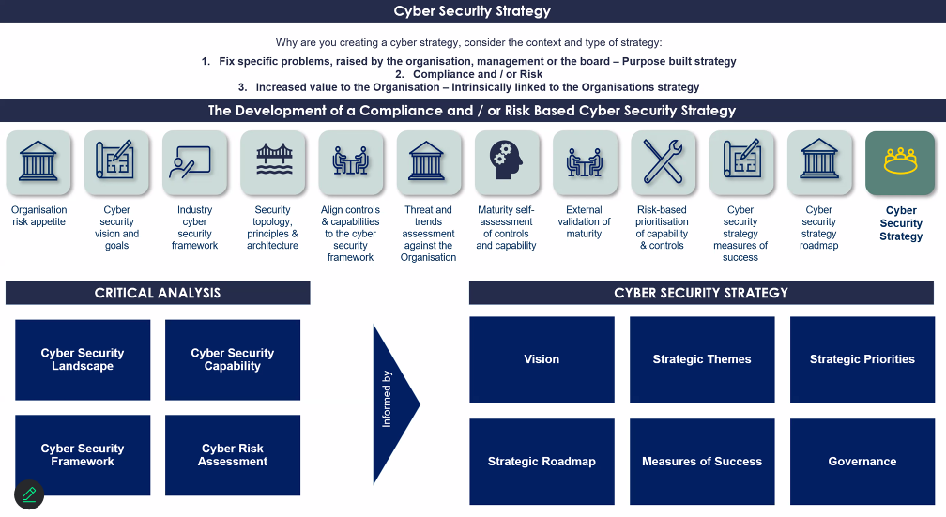

Cyber strategy and collaboration
Notes:
Challenge coming from the COO community was to better equip CISO’s to develop and deliver cyber strategies for their organisations.
This year there have been new CISO’s come into the sector and others that have been asked to develop such strategies.
We’ve held workshop sessions whereby those that have developed in the past have shared their approaches to developing. For myself, I eluded to knowing why your developing a strategy and what is the context.
3 types of cyber strategies developed:
1 - to address an existing issue or problems, whether they be incident based, finance or some other pressure or any other thing that has been raised by the organisation’s management or board
2 –A compliance or risk aligned strategy – after all cyber security is really a series of controls to mitigate a business risk
3 – A value proposition or a way to increase value to the organization. This is usually intrinsically linked to the organization’s strategy.
I shared the topology for a compliance or risk aligned strategy for Flinders University. It is not too dissimilar to one that Karl developed for UniSA too.

Slide 6

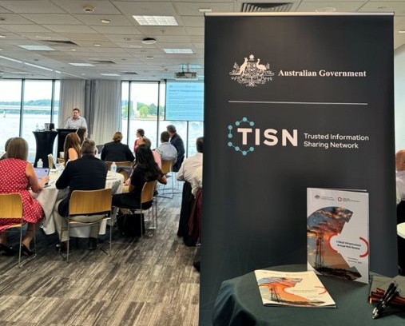

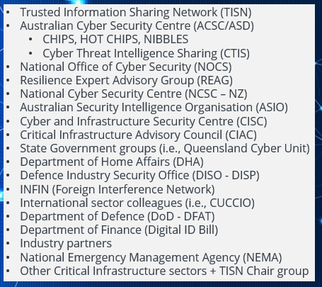
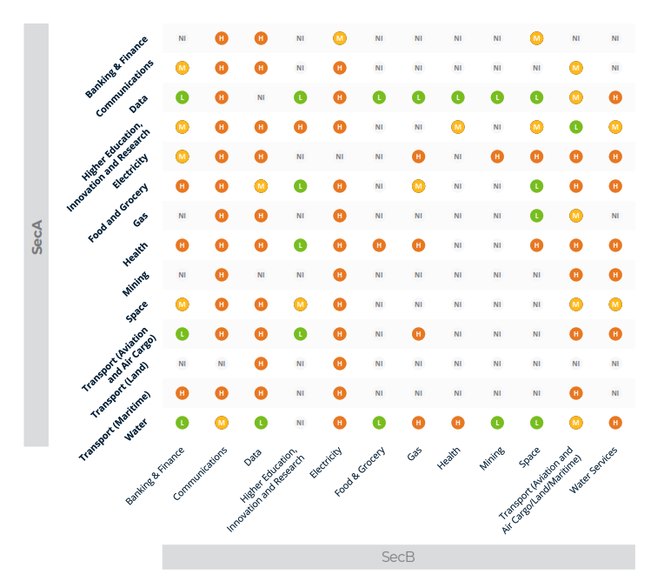
Connections
Notes:
Sharing and Connection TISN AU, Chips, ACSC, REAG, DISP, INFIN

Slide 7

Australasian Higher Education sector –
2024 CAUDIT cybersecurity benchmarking
The CISO
Cybersecurity in the Institution
The cybersecurity team
Funding and budgeting
Cybersecurity insurance
Training and awareness
Security incidents and threats
Digital identity and access management
Compliance, legislation, and standards: SoCI, DISP, FI
Third party risk management
Future cybersecurity priorities
Notes:
CAUDIT has a benchmarking pedigree. CAUDIT has provided a Benchmarking service since 2003. This is a key element of AHECS, bringing to the fore the individual strengths of the partners.
With the AHECS initiative it was quickly identified that there is limited higher education benchmarking. Any benchmarking was general externally sourced and at best may contain data from a few institutions.
CAUDIT, through AHECS, have undertaken three new, standalone cybersecurity benchmarking surveys. Baseline and Maturity commenced in 2020 and Systems was introduced in 2022 to expand on existing benchmarking.
Participation in benchmarking was on a voluntary basis.
Baseline benchmarking covered 11 major areas including the CISO, Cybersecurity in the Institution, Cybersecurity Frameworks and Standards, Governance, Cyber Threats, Funding of Cybersecurity and Future Cybersecurity Priorities.
Our systems benchmarking goes into more detail regarding the particular systems in use across institutions, security operations, vulnerability management, and incident response.
And this information becomes valuable when institutions are working on project activities for upgrades or system changes or have system specific queries
From the benchmarking aggregated, we provide anonymised results to all participating institutions.
4th year

Slide 8
Perceived cybersecurity threats
(Australia and New Zealand: 2021-24)
Notes:
Unpatched vulnerabilities
Ransomware
Phishing
Increase insider threat 2024
Reduce remote work
Reduce IP theft

Slide 9
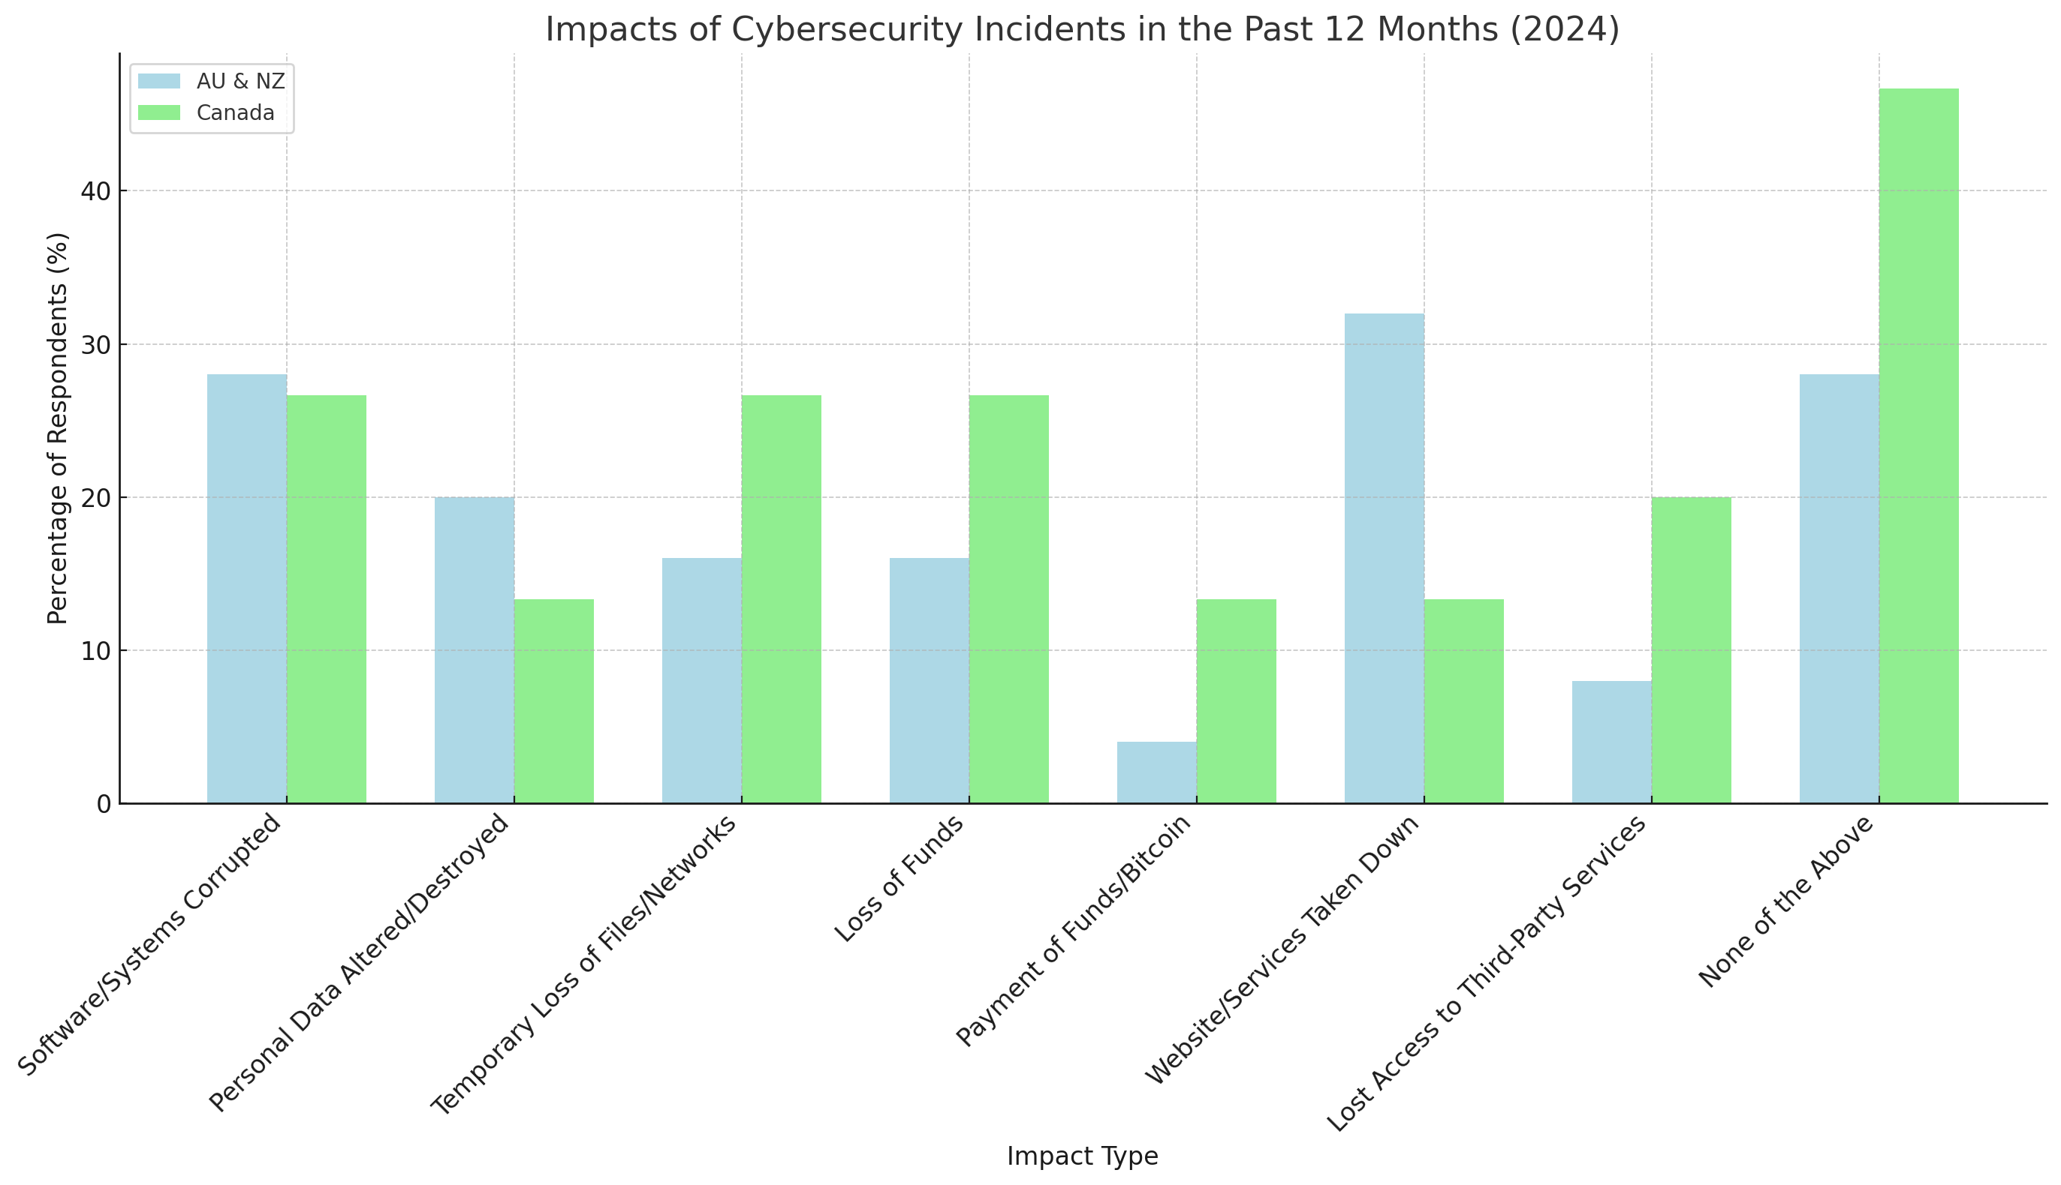
Incident impact
(Australia and New Zealand vs Canada: 2024)
Notes:
Vs Canada for this year
NOTE small sample size Canada
Fairly similar,
Higher ddos AU

Slide 10
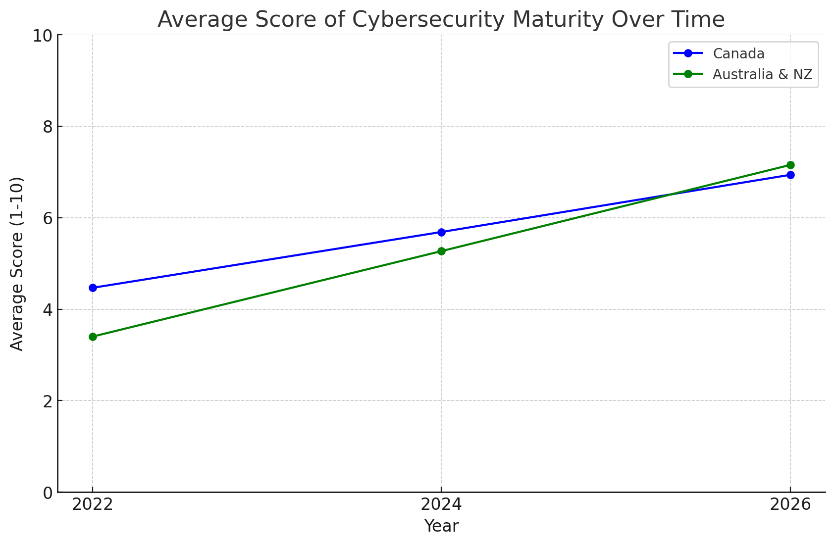
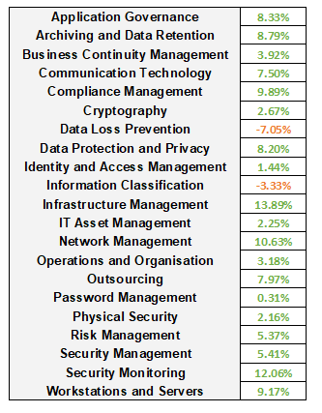
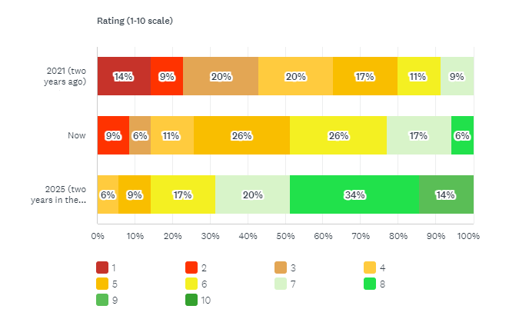
Self-reported cybersecurity maturity
(Australia and New Zealand vs Canada: 2024)
Notes:
Overall cyber maturity
Increasing – optimism
More standards (INCL nz)
Lower maturity against standards
Linke between compliance maturity and self reported?
Collab efforts + collective wisdom
On a scale from 1 to 10, how closely your institution resembled an ideal (or your ideal) cybersecurity institution?Note: the rating will be subjective. This will act as a measure of the intent of the sector to mature cybersecurity and as a point for discussion for CISOs. Note that a maturity of level 8 might be the high water mark for one institution as reflective of their threat landscape and risk profile, while it may be 7 or 9 for another.
The first item I wanted to discuss is the self-reported assessment on cybersecurity maturity. Respondents were asked to rate their previous, current, and perceived future maturity pertaining to cybersecurity.
The image on the screen shows this result. While the input is self assessed, with aggregation across the sector, it demonstrates an overall increasing cybersecurity maturity and ongoing investment with aspirational improved maturity.

Slide 11
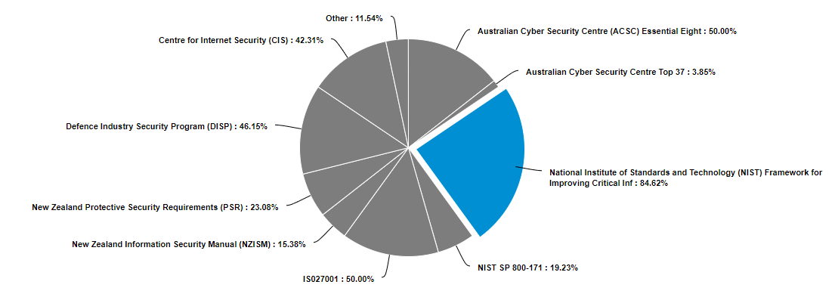
DISP, FI, SoCI & compliance
Over half fall under SoCI
Varied approaches, ‘everything is critical (4.35%), 21.74% no critical education assets, 35% ‘still figuring it out’
Half DISP entry or higher
Another 20% applying in next year
FI training bespoke
minimal/under development
Varied responsibility
Varied reporting
+ multiple reporting
Notes:
In Australia, the higher education and research sector falls under the Security of Critical Infrastructure Act 2018. Australian respondents were asked whether their institution is considered a critical education asset under the act (undertaking critical research relevant to national security, defence, or another critical sector). Over half (56.52%) indicated yes. In response to identifying critical education assets, institutions have taken varied approaches. A small percentage (4.35%) of institutions have adopted an 'everything is critical' approach, treating all assets as critical by default. About a fifth (21.74%) have determined that they have no applicable critical research and are unlikely to have any in the future. A significant portion (34.78%) are still in the process of figuring out how to identify their critical assets, indicating an ongoing challenge in this area. Meanwhile, 30.43% of institutions have identified some critical research and implemented ongoing processes, such as ethics or complex research reviews, to continually assess and manage these assets. Additionally, 21.74% have taken other approaches, such as focusing on systems with a large volume of personally identifiable information (PII) or applying continuous review processes to identified critical research.

Slide 12
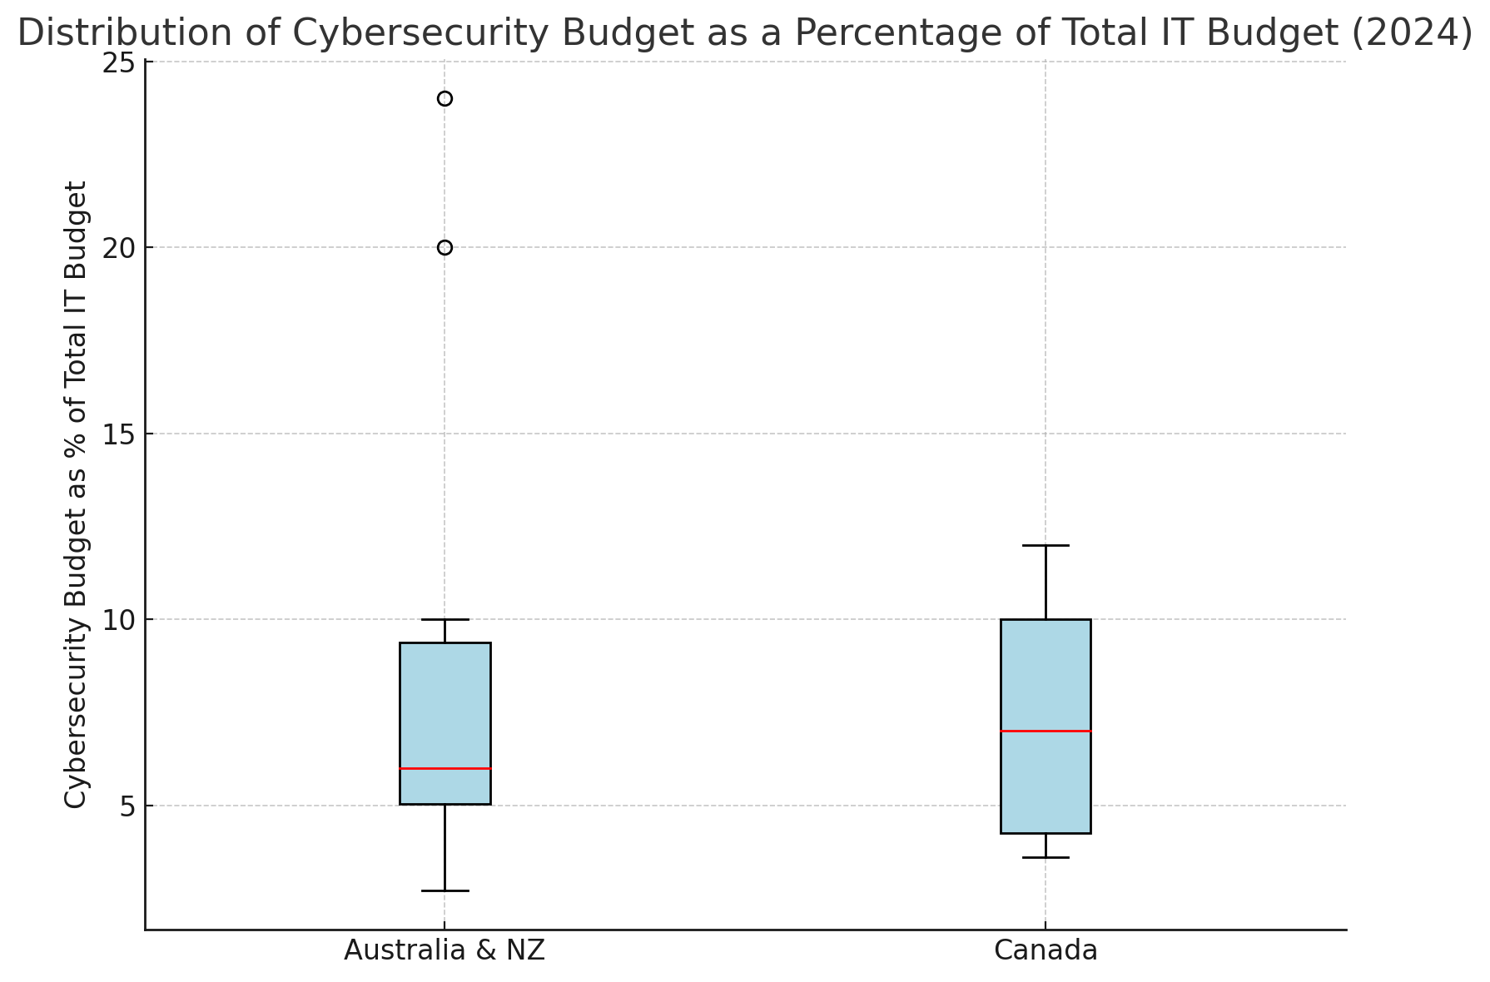
WHY DOES IT MATTER?
Investing in a cybersecurity measure like a secured cloud (i.e., Nebula) actually can contribute to research security, and
If we are already bumping up our cybersec budgets, why not spend it on a research security measure
Notes:
--- maybe this graph on this slide, can mention budget?

Slide 13
What Kind of Data are We Talking About?
Student and staff records
Intellectual property / patented items
Export controlled items and technical data (both military and “dual use)
Funding contracts (incl. details about funding parties)
Corporate data (in the case of spin-offs and JVs)

Slide 14

Hardly any University Research is “Classified”
SENSING & DETECTION
HYPERSONICS
AUTONOMOUS VEHICLES
CYBERSECURITY
There are no specific numbers available on precisely how much Defence research is being done in Australia
However, based on media statements from Group of Eight and Universities Australia, a rough estimate is $100 million (out of $11.8 billion of funding)
That’s less than 1% of total Australian government funding!
CLEAN ENERGY
ARTIFICIAL INTELLIGENCE
GENETIC ENGINEERING
CROP SCIENCE
METAMATERIALS
QUANTUM

Slide 15
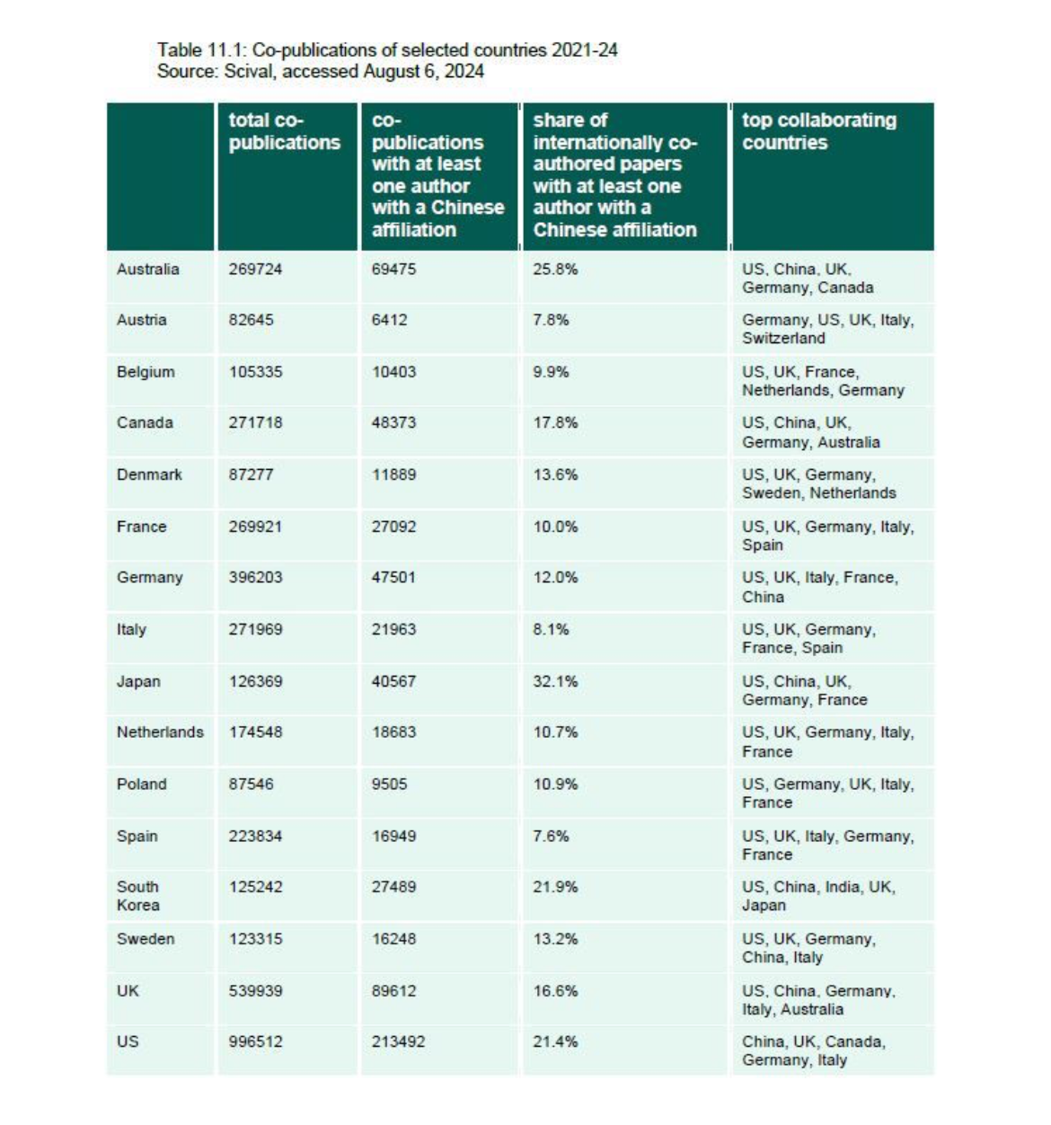
Collaborations with Foreign Partners
Collaborations, both bilateral and multilateral, are increasing
Funding bodies are increasingly looking for multi-country and/or multi-partner bids
This increases the risk that a party to a research contract might not be who they say they are

Slide 16
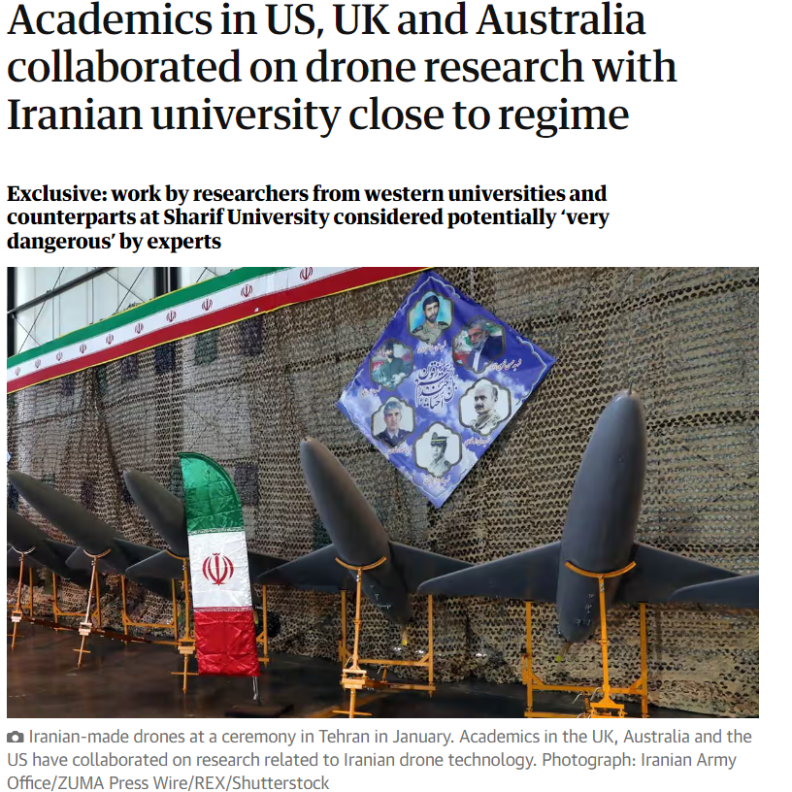
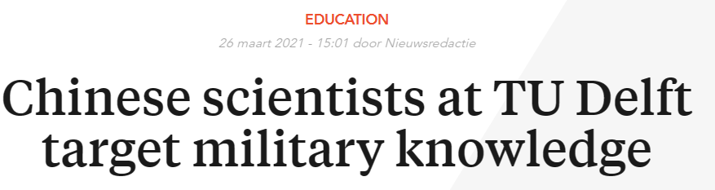
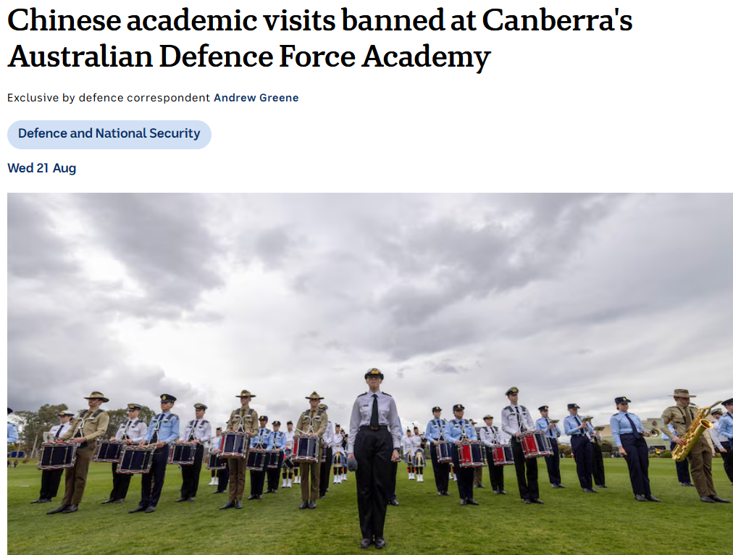
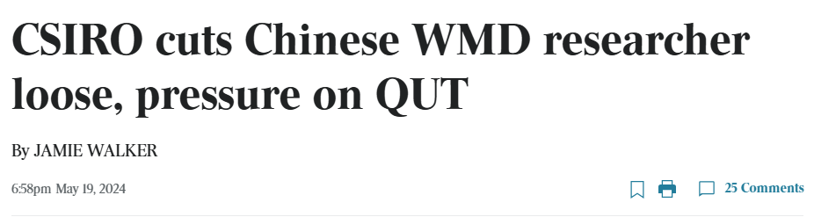

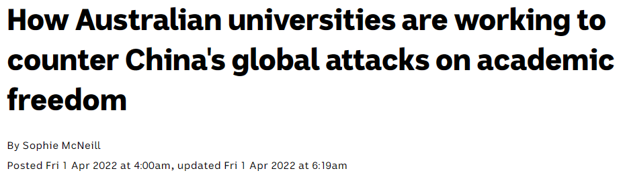
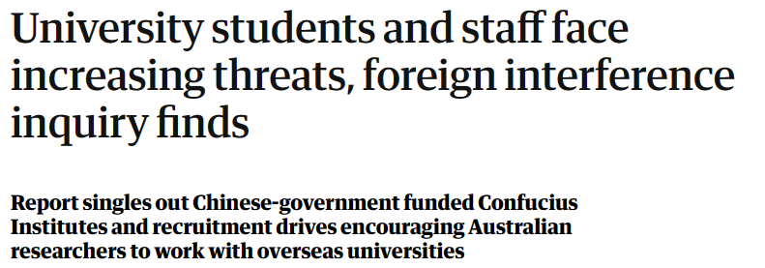

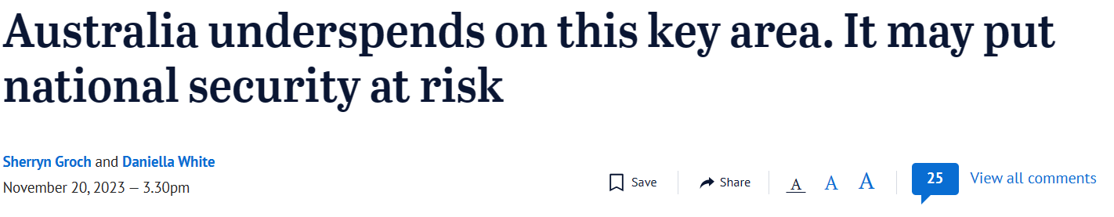
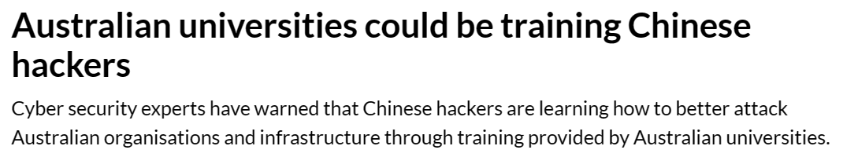
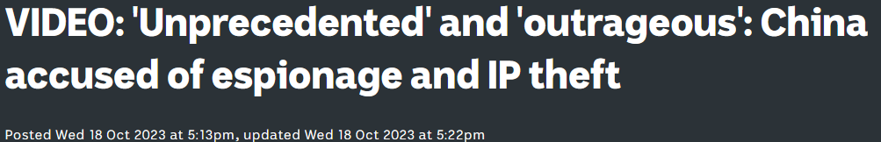
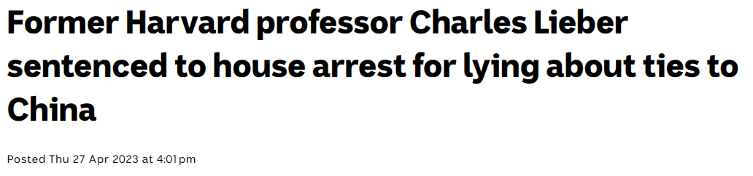
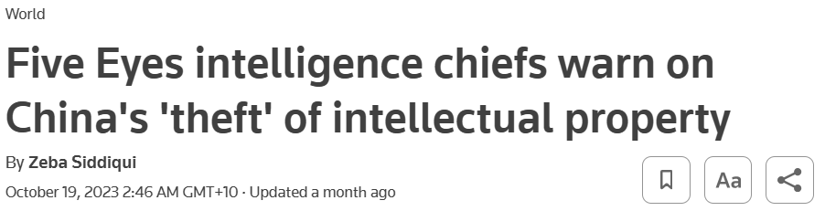
So why does that matter for data security?

Slide 17
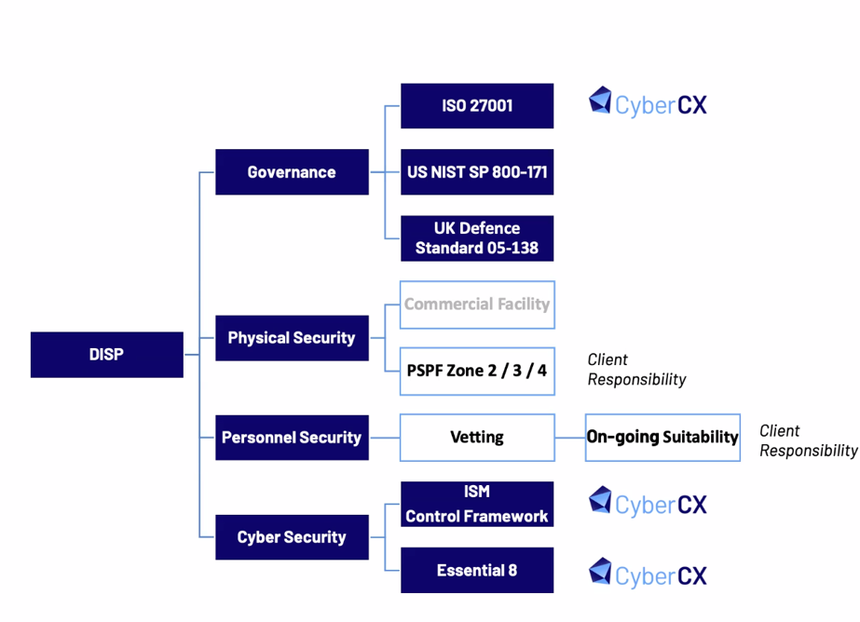
NEBULA
Currently, Australia’s only PROTECTED research cloud platform, operated by CyberCX
A sovereign cloud platform, purpose-built to meet the secure research needs of academic institutions, business, and government offered as-a-service.*
Incorporates Microsoft Azure products as standard
NOTE: Nebula does not protect personnel or physical security.
* CyberCX website: https://cybercx.com.au/protected-cloud/

Slide 18
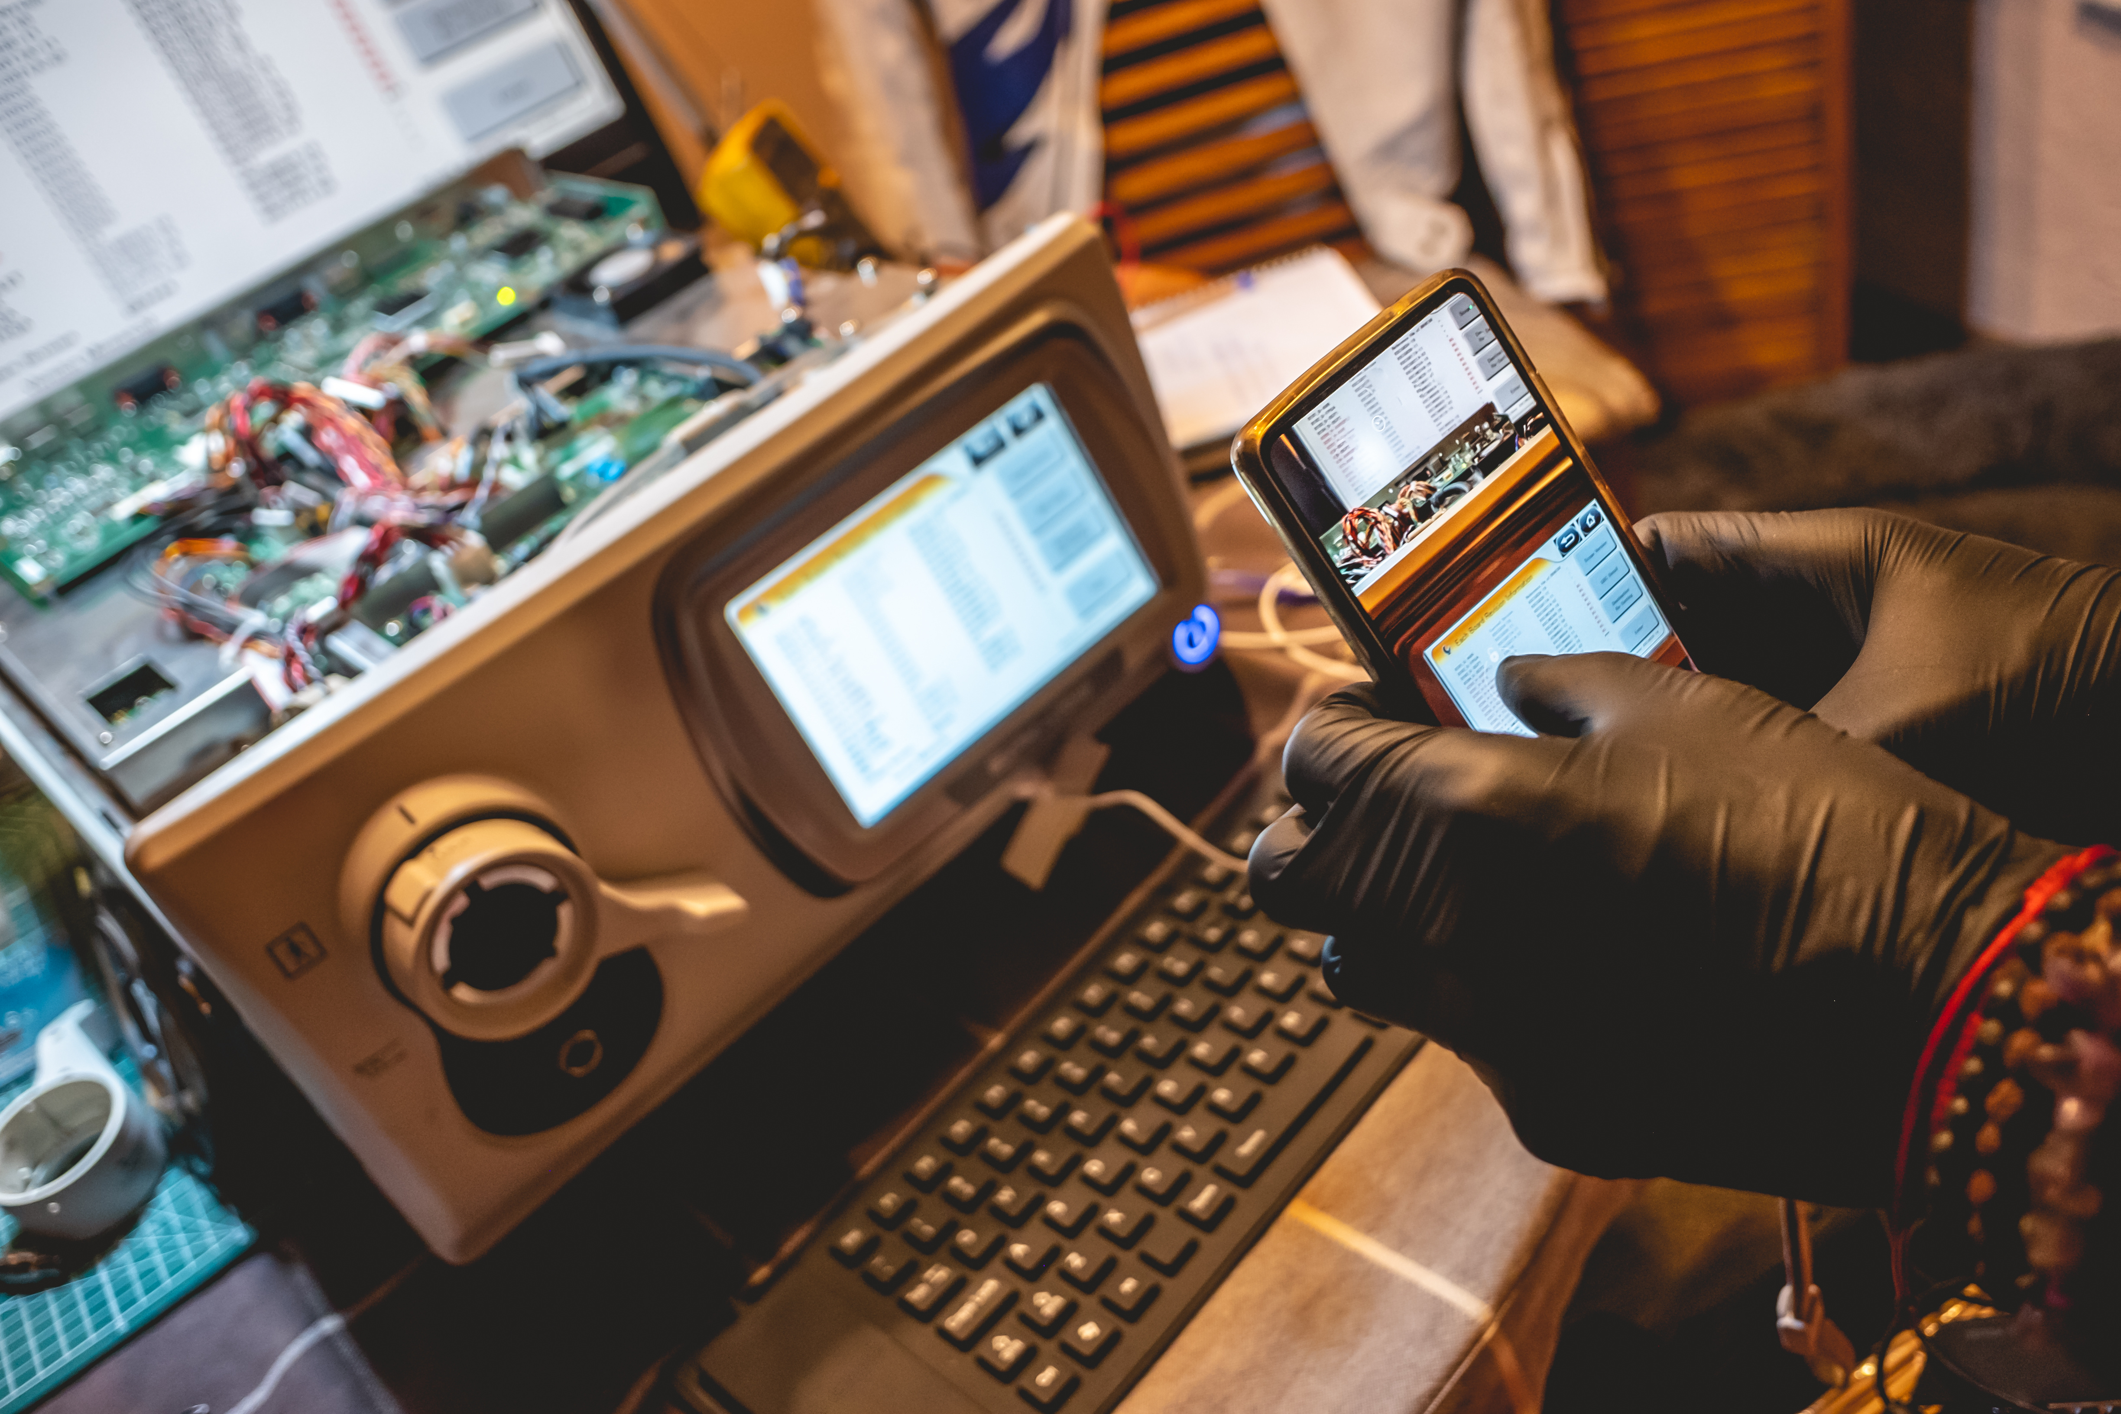
Why Does Personnel and Physical Security Matter?
Highest security levels will not stop improperly addressed insider threats
Research undertaken by specific individuals can lead to them being specific targets – i.e., China’s “Greybeard” strategy, PWC scandal
Security of the cloud will not affect compromised credentials, tokens or architecture (i.e., USB drives)
Stealing the data may not be their objective – destroying it might be

Slide 19
Key Takeaways
The cybersecurity threats facing Australian universities and higher education are likely to increase and diversify, not decrease
Our higher education institutions are already repositories of significant amounts of data with a “national interest” – so they will need to take more steps and invest more resources into securing that data
Increased cybersecurity spend and secured cloud environments are just two ways that our institutions can achieve this protective mission, whilst enabling collaboration amongst our research partners

